Slide 1
Journey into an Election Year with Civility in Faithful Citizenship
Presented by John Andrews
Combined Vicariate Meetings 2020

Slide 2
Goals
Understand and Discuss Current Political Climate
Return to Civility
Strategies for Encouraging Faithful Citizenship

Slide 3
The Landscape
Impeachment and acquittal of President Trump
2020 General Election
We are more polarized than ever

Slide 4
Pew Study A majority of Democrats and Republicans now describe each other this way
“Immoral”
“Unpatriotic”
“Close-minded”

Slide 5
Pew Study
Can’t agree on basic facts (73%)
Don’t share the same values/goals
55% of Democrats
62% of Republicans
Both parties “too extreme”
60% of Americans

Slide 6
Politics and the U.S. Church
Party affiliation among U.S. Catholics is now evenly split
Party positions on moral issues often trump Church teaching
→Abortion →Immigration
→Climate Change →Aid to the poor
→Marriage →Death Penalty

Slide 7
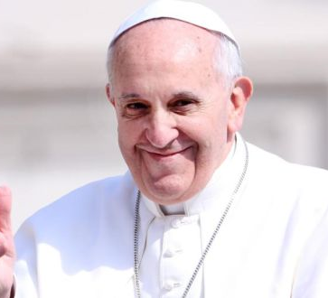
Pope Francis and the U.S. Church
“Too liberal” 55% of Republicans
“Change for the better” 71% of Democrats

Slide 8
Pope Francis on Polarization
“…we must especially guard against the simplistic reductionism which sees only good or evil; or, if you will, the righteous and sinners. The contemporary world, with its open wounds which affect so many of our brothers and sisters, demands that we confront every form of polarization which would divide it into these two camps.”

Slide 9
Cultural Considerations
Experience of foreign-born priests and religious regarding political participation may be different
Must be intentional in encouraging participation
Climate around immigration is a major factor for some

Slide 10
Our Response
Diocesan
U.S. Bishops
Pope Francis

Slide 11
Bishop Barnes Message

Slide 12
For Sharing
What challenges are you facing in your ministry that are related to the discussion of politics and the upcoming general election?
How does faith inform your participation in civic matters and the political process?
What is your level of comfort in discussing matters of politics and public policy in the parish/ministry setting?

Slide 13
U.S. Bishops
Forming Consciences for Faithful Citizenship
Civilize It campaign

Slide 14
Pastoral Letter of US Bishops released every 4 years
Introduction is customized
Formation of Conscience
Catholic Social Teaching
The Common Good

Slide 15
“….our participation in political parties or other groups to which we may belong should be influenced by our faith, not the other way around.”

Slide 16
“…We are constantly challenged to get the message across that we’re not a political party and we don’t follow a political platform with the issues. On some issues, one party is more favorable to what we understand is for the common good and, on other issues, another party might be more favorable.”
- Archbishop Salvatore Cordileone

Slide 17
Faithful Citizenship
Insert Faithful Citizenship Video

Slide 18
Civilize It
Interdenominational program launched November 2019
“Dignity beyond the debate”
Families, parishes, workplaces
Public figures

Slide 19
Civilize It – Practical Steps
Commit to dialogue with people closest to you
Engage in (at least one) civil dialogue in your community
Take the pledge

Slide 20
Civilize It – the Pledge
Civility
I pledge to recognize the human dignity of those with whom I disagree, treat others with respect, and rise above attacks when directed at me

Slide 21
Civilize It – the Pledge
Clarity
I pledge to root my political viewpoints in the Gospel and a well-formed conscience, which involves prayer, conversation, study and listening.
I will stand up for my convictions and speak out when I witness language that disparages others' dignity, while also listening and seeking to understand others’ experiences.

Slide 22
Civilize It – the Pledge
Compassion
I pledge to encounter others with a tone and posture which affirms that I honor the dignity of others and invites others to do the same.
I will presume others’ best intentions and listen to their stories with empathy. I will strive to understand before seeking to be understood.

Slide 23
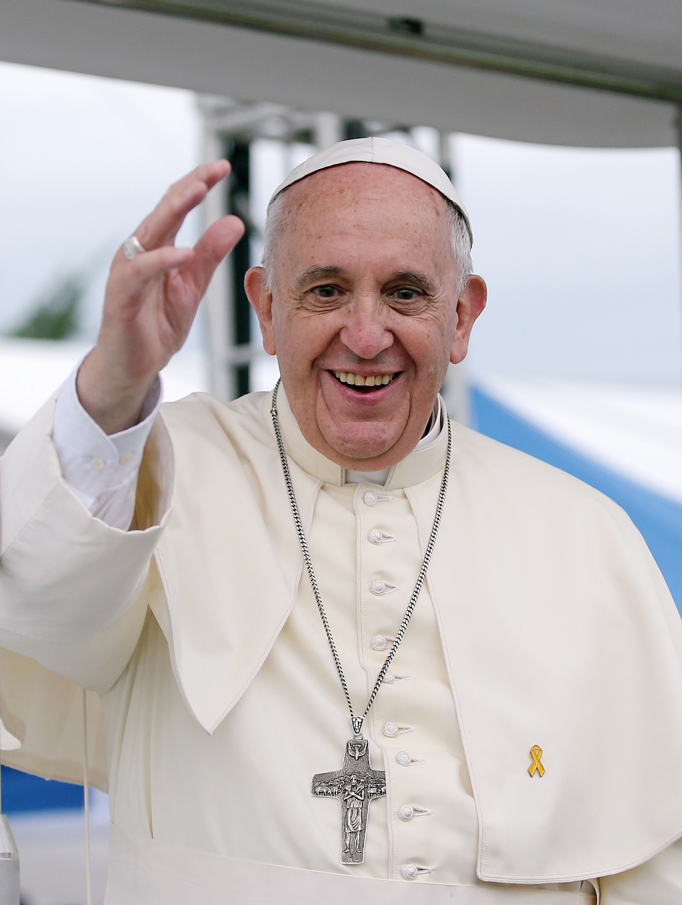
From Pope Francis
“…No one can demand that religion should be relegated to the inner sanctum of personal life, without influence on societal and national life, without concern for the soundness of civil institutions, without a right to offer an opinion on events affecting society….
“Who would claim to lock up in a church and silence the message of Saint Francis of Assisi or Blessed Teresa of Calcutta? They themselves would have found this unacceptable.”
-Evangelii Gaudium

Slide 24
From Pope Francis
Polarization is a worldwide trend
We must speak with one voice
We must speak through official pronouncements
Bishops cannot be identified with any political party
What he fears most…. division

Slide 25
What to do in your parish
Incorporate Faithful Citizenship and Civilize It into parish formation/education ministries
Share church teaching on human life, human rights, and justice and peace
Promote at Mass (bulletin inserts, pulpit announcements, homilies)
Conduct a non-partisan voter registration drive on church property
Only distribute election materials produced by the Diocese, California Catholic Conference or USCCB.
Promote participation in the 2020 Census

Slide 26
What not to do in your parish
Endorse or oppose candidates for political office
Make church facilities available for partisan political purposes
Conduct voter registration slanted toward one party
Distribute materials not produced by the Diocese, the CCC or the USCCB
Allow political candidates to speak at Mass or other parish gatherings

Slide 27
Conscience Formation
“The voice of God resounding in the human heart.”
Calls us to love good and avoid evil
Formed throughout our lifetime
Our faith community helps us to form it

Slide 28
Conscience Formation
Open ourselves to the truth
Study scripture and Church teaching
Examine the facts and background info
Prayerfully reflect to discern the will of God

Slide 29
Final Thoughts
Polarization tempts us to be silent – we cannot be.
We cannot tell our people how to vote, but we can encourage participation, reflection, critical thinking and prayer
When in doubt, bridge to Church teachings
Republicans, Democrats and all others have the same inherent dignity given by God. Remember that this election season!

Slide 30
QUESTIONS?

